Slide 1
Problem solving with sequences
Task A: Generalising from non-sequential terms
1) Fill in the missing terms in these arithmetic sequences.
Term number (n) | 1 | 2 | 3 | 4 | 5 | 6
a) |  |  |  | 1 | 10
b) |  | 1 |  |  | 10
c) |  | 1 |  | 10
d) | 10 |  |  |  | 1
2) What happens when you try to find the missing terms in this sequence? What does that tell you about this sequence?
2, 12, 22, 32, 65, 98, …
3) The 23rd term of an arithmetic sequence is 187 and the 45th term is 363.
a) Find the 100th term.
b) Will 3634 be a term in this sequence?

Slide 2
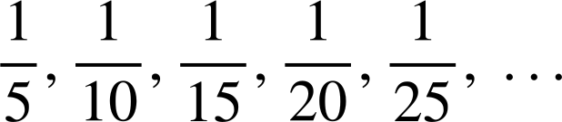

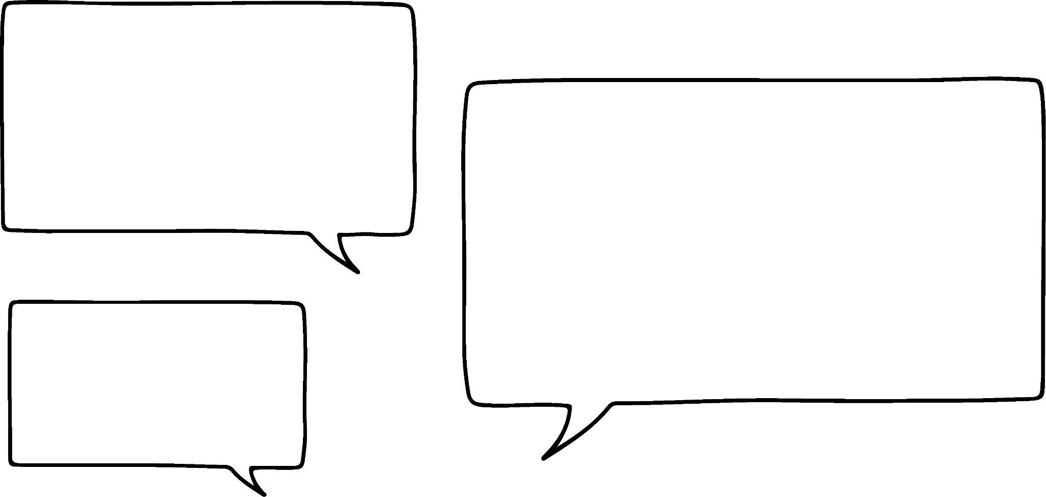

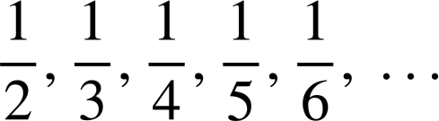
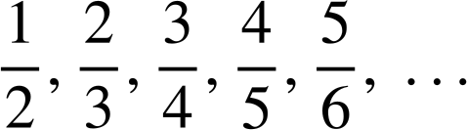
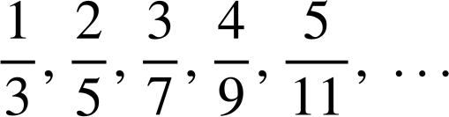
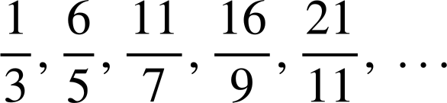
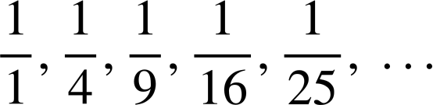
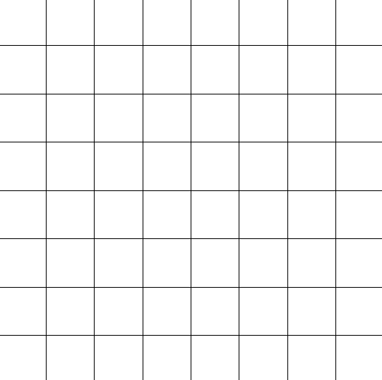
Problem solving with sequences
Task B: Fractional sequences
1) Jun and Laura are looking at a sequence.
5, 10, 15, 20, 25, …
This is an increasing sequence.
5, 10, 15, 20, 25, … That’s 5n.
This is an arithmetic sequence.
a) Justify why Jun is wrong.
b) Justify why Laura is wrong.
2) Write an n^{th} term for these fractional sequences.
a)
b)
c)
d)
e)
Task C: Pattern spotting
1) How many squares are there on a chess board?
Don’t forget to consider all the squares!
Mathematics in Education and Industry.

